Slide 1
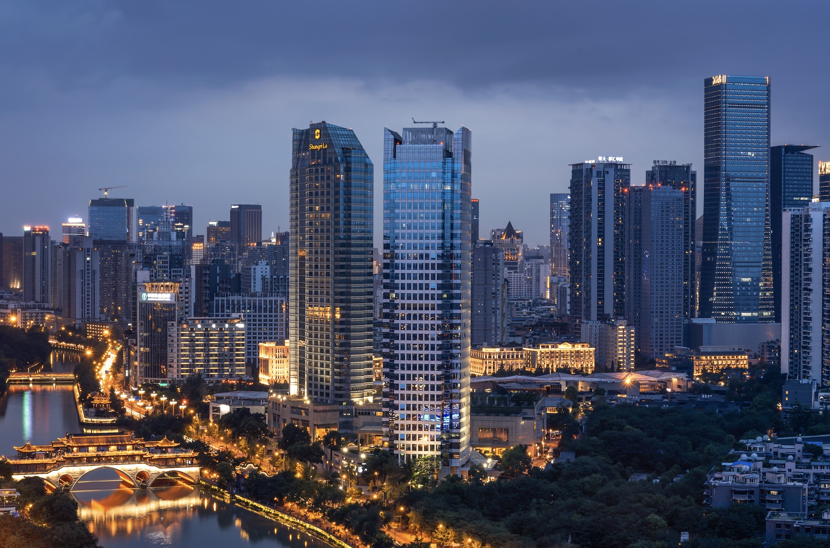

Asian Metal
（12th Antimony Summit）
Online Room Booking Guide

Slide 2
The online booking portal will close on April 6, 2026.
Please book early to secure your room.
Deluxe City View King Room RMB700nett with one daily breakfasts
Deluxe City View Twin Room RMB800nett with two daily breakfasts
Deluxe River View King Room RMB800nett with one daily breakfas
Deluxe River View Twin Room RMB900nett with two daily breakfasts
Horizon River View King Room RMB1300nett with one daily breakfasts
Horizon River View Twin Room RMB1400nett with two daily breakfasts
Executive Suite Room RMB1600nett with two daily breakfasts

Slide 3
1.Open one of the following links to access the booking interface:
Chinese version:
http://www.shangri-la.com/reservations/booking/sc/index.aspx?hid=SLCD&group_code=JIN090426&check_in=20260407&check_out=20260413
English version:
http://www.shangri-la.com/reservations/booking/en/index.aspx?hid=SLCD&group_code=JIN090426&check_in=20260407&check_out=20260413

Slide 4
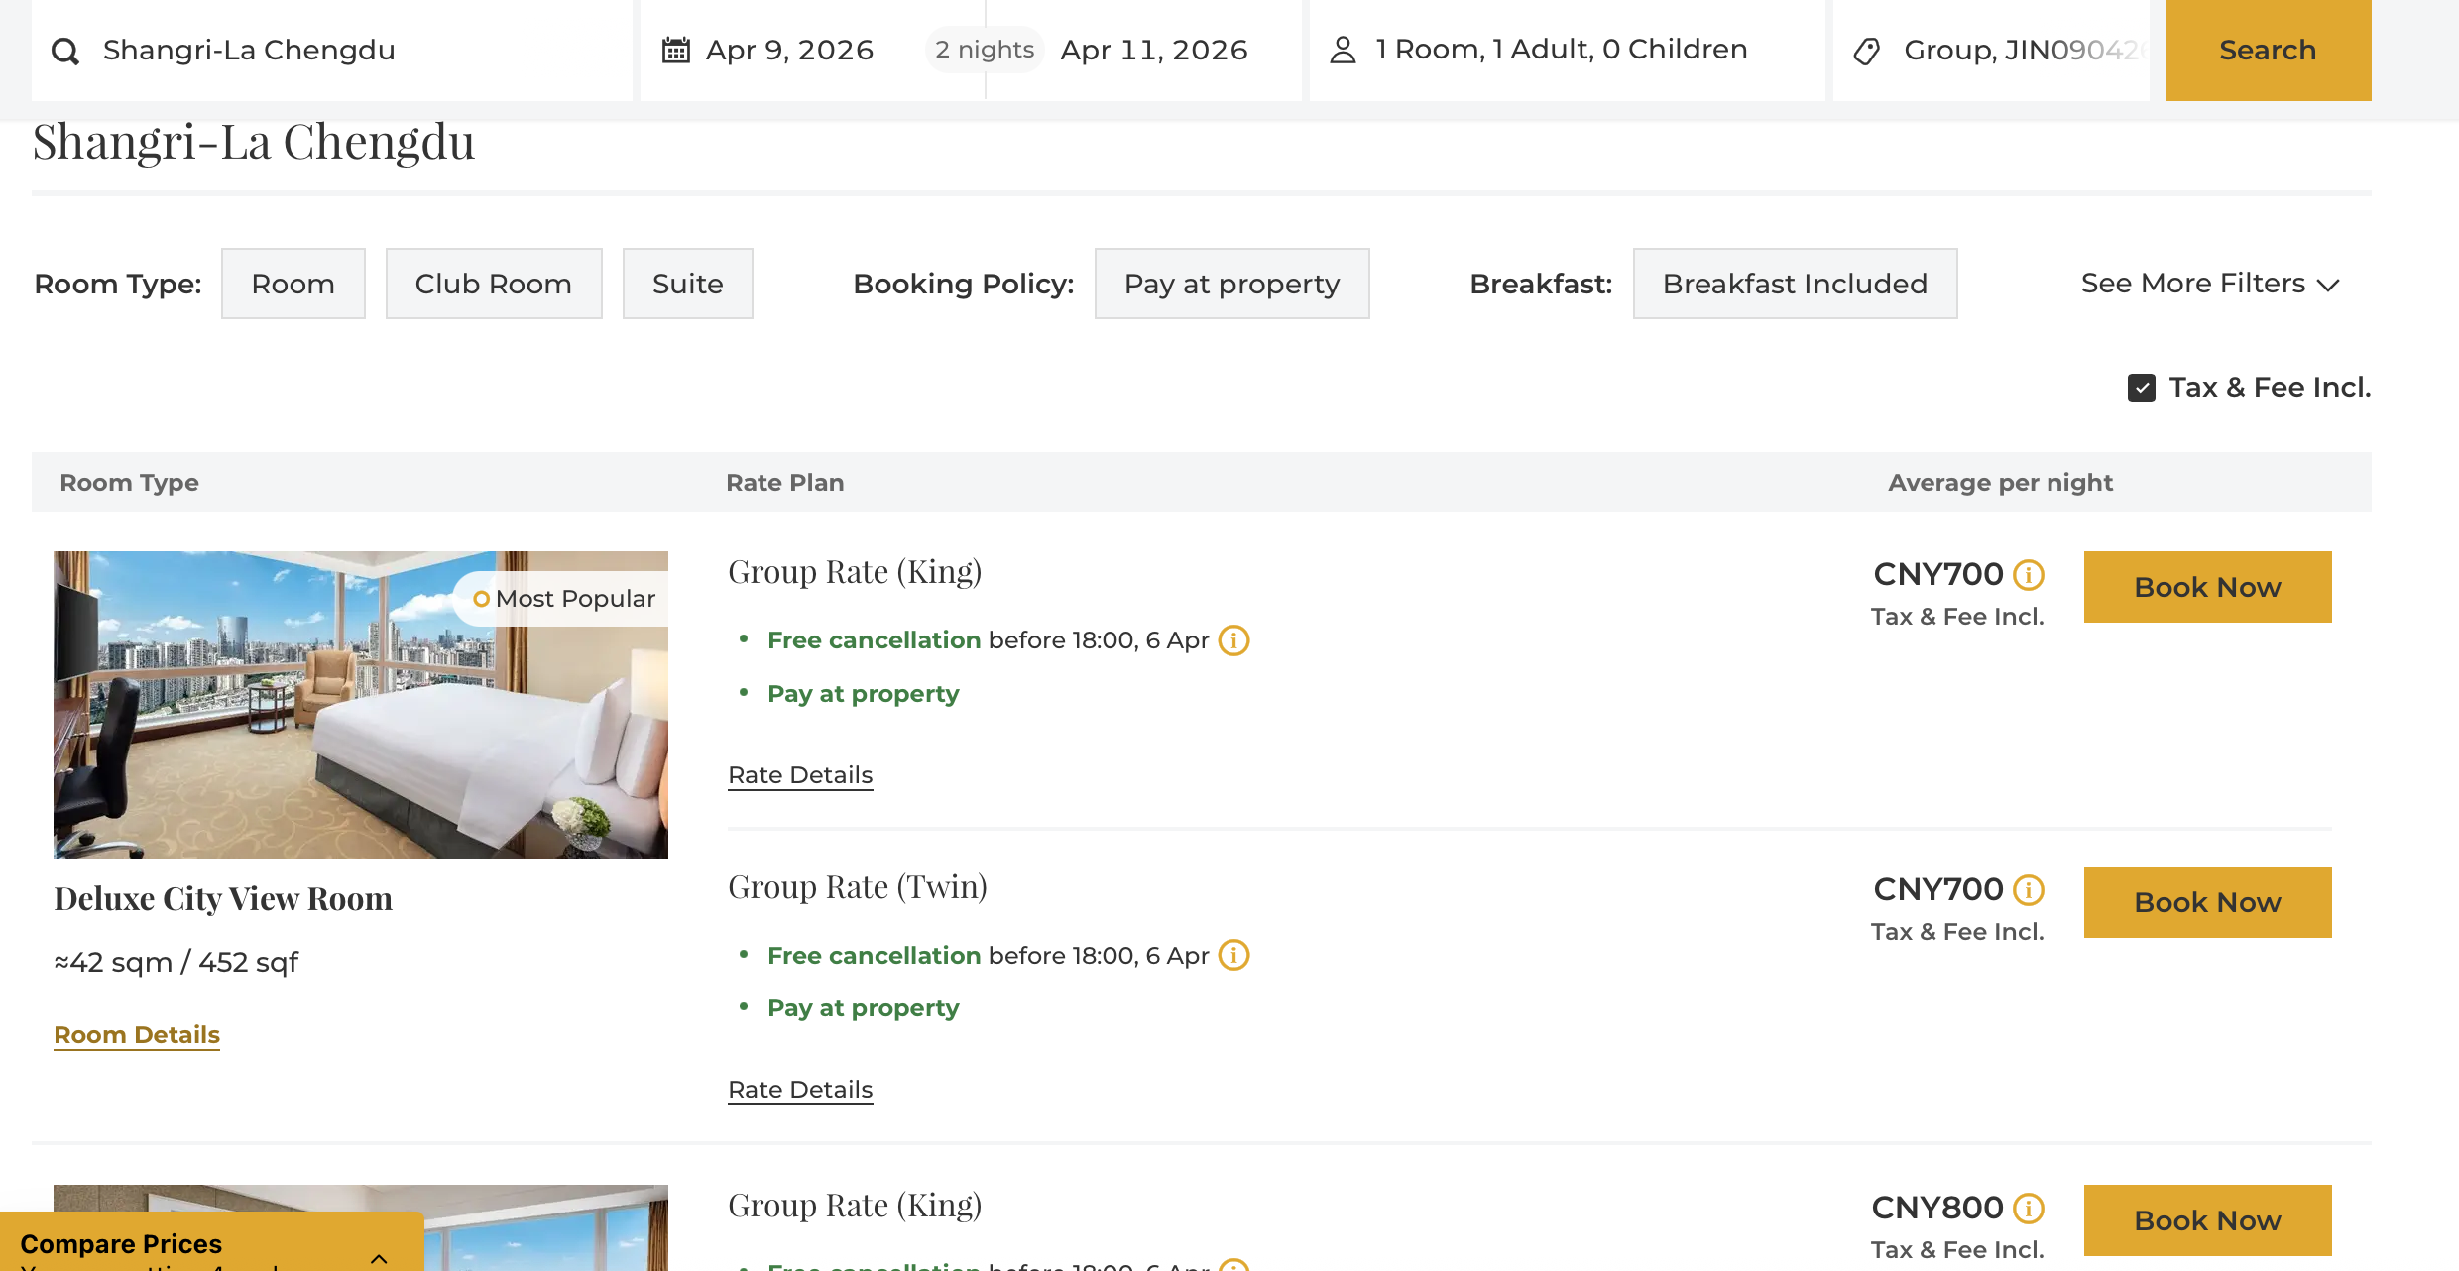
2.Select Your Room
Choose your preferred check-in and check-out dates.
Select your desired room type.
Click the "Book Now".

Slide 5
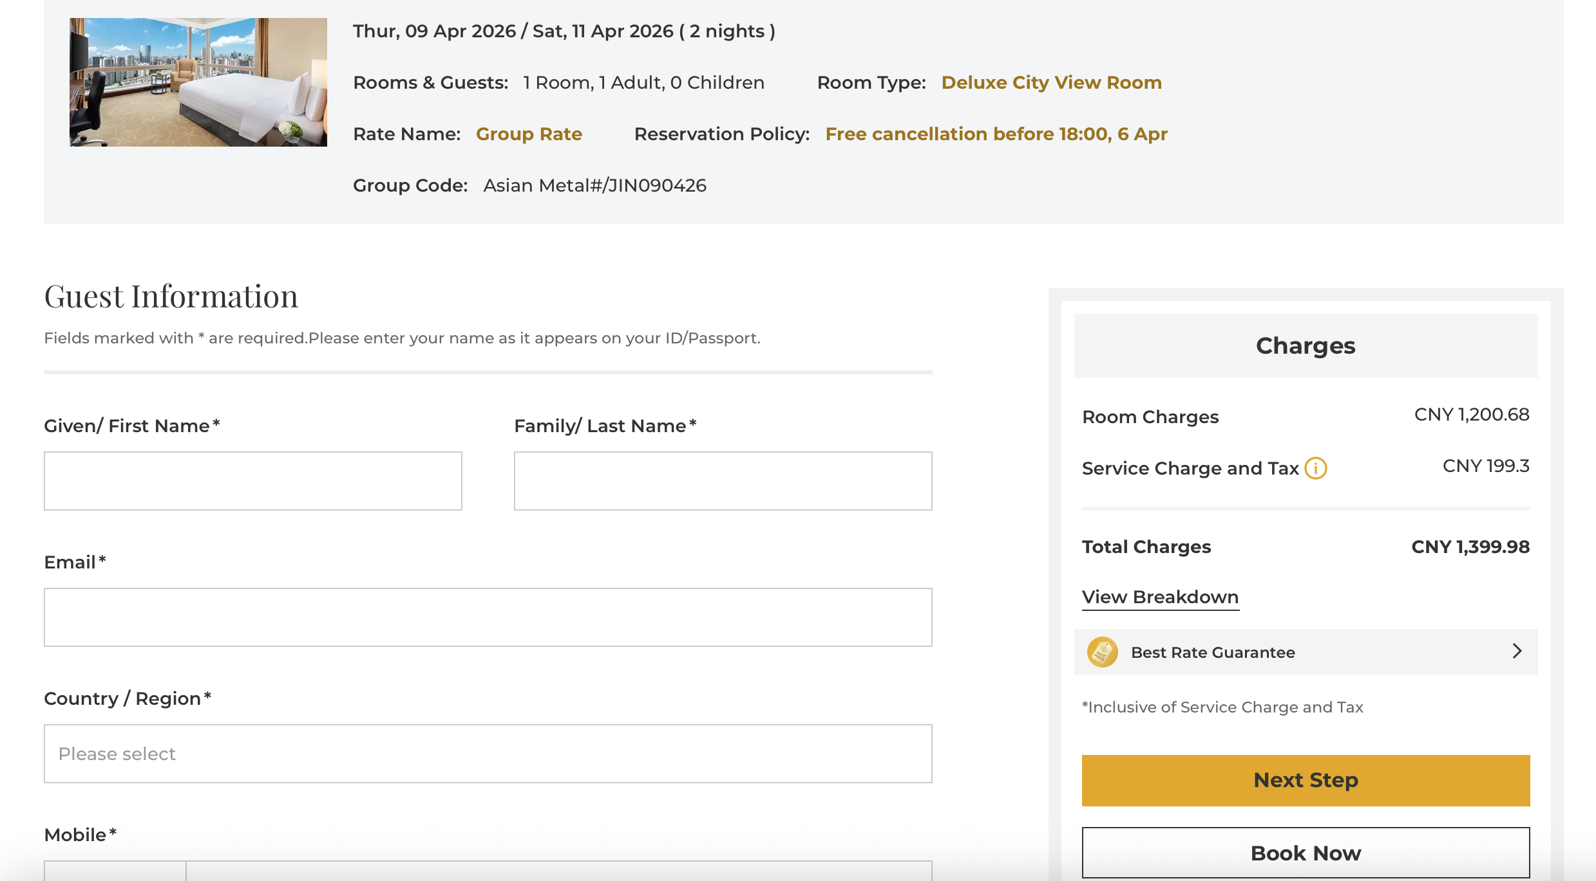
3.Enter Guest Details & Payment
The total price for your stay will be displayed here.
Fill in the required guest information.
Click "Book Now" to proceed to the next page.
Select "Guarantee with Credit Card" and submit your credit card number and expiry date to secure your reservation.
Click "Complete Booking" to finish the reservation process.

Slide 6
4.Reservation Confirmation
Upon successful booking, a confirmation email will be sent to the email address you provided.
Please carefully review your details on the confirmation page/in email: Hotel name, check-in/out dates, room type, total cost, and reservation confirmation number.
Keep the confirmation number safe. You will need to present it (or your name) at check-in.
If you have any questions, please contact the Hotel Reservations Department or the Hotel Sales Manager.
If you have any questions, please Call 028-8888 9999 to the Reservation Department.
Hotel Sales Contact: Zhao Rong (Lynn), Mobile: 13880777018
Please call and inform that you are a guest from Asia Metal (12th Antimony Summit) team.

